Slide 1
SINGULAR VALUE DECOMPOSITION (SVD) Image Compression
SANMAT SANJAYAKUMAR PAYAGOUDAR – PES1UG20CS385
SANJAY K N – PES1UG20CS379
SHAMITH V S – PES1UG20CS390
SANKALP DEVANAND – PES1UG20CS381

Slide 2
DESCRIPTION
We often need to transmit and store the images in many applications. Smaller the image, less is the cost associated with transmission and storage. So we often need to apply data compression techniques to reduce the storage space consumed by the image. One approach is to apply Singular Value Decomposition (SVD) on the image matrix. In this method, digital image is given to SVD. SVD refactors the given digital image into three matrices. Singular values are used to refactor the image and at the end of this process, image is represented with smaller set of values, hence reducing the storage space required by the image. Goal here is to achieve the image compression while preserving the important features which describe the original image.

Slide 3
STEP – 1 A digital image is given to SVD. SVD refactors the given digital image into three matrices.
Formula : M=UΣVᵗ
M - Original matrix we want to decompose
U - Left singular matrix (columns are left singular vectors). U columns contain eigenvectors of matrix MMᵗ
Σ - Diagonal matrix containing singular (eigen) values
V - Right singular matrix (column are right singular vector). V columns contain eigenvectors of matrix MᵗM

Slide 4
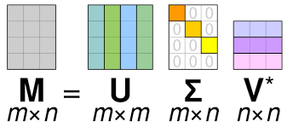
SVD : FORMULA

Slide 5
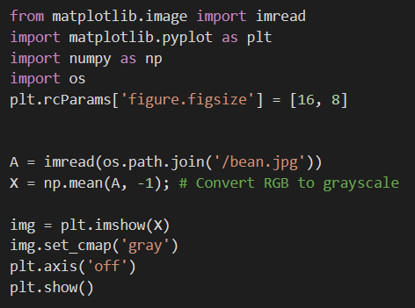
CODE

Slide 6

ORIGINAL IMAGE

Slide 7
STEP - 2
Singular values are used to refactor the image and at the end of this process, image is represented with smaller set of values, hence reducing the storage space required by the image.

Slide 8
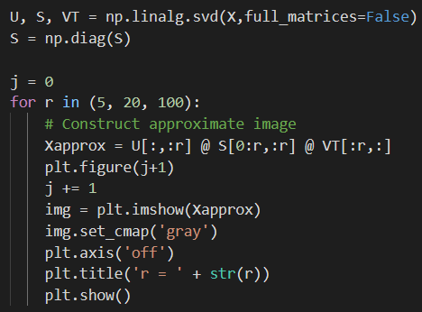
CODE

Slide 9
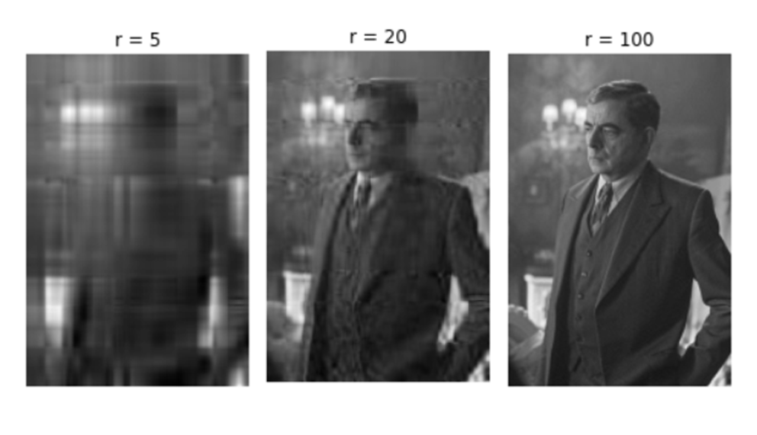
OUT PUT

Slide 10
GRAPH
WE R PLOTING 2 GRAPHS
Log of SINGULAR VALUES (σj) vs j
CUMULATIVE SINGULAR VALUES vs j
We can conclude that considering first few values of the Diagonal matrix(Σ – Matrix containing singular value) is as similar as considering all the values.

Slide 11
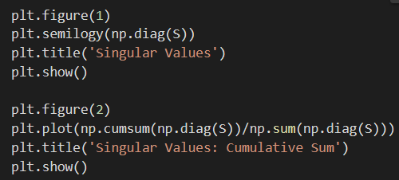
GRAPH : CODE

Slide 12
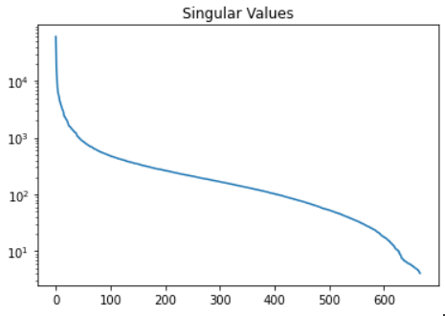
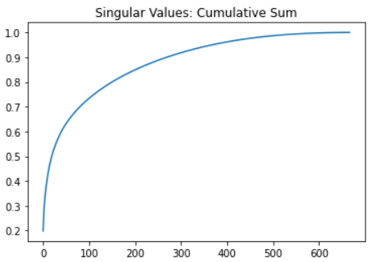
OUTPUT:

